Slide 1


ATLIQO TELECOM
5G Impact Analysis
Subhojeet Sarkar

Slide 2

Executive Overview
5G Launched in May 2022 with expectations
Initial excitement met with mixed market reception.
Active Users Decline, Leading to Churn Issues
User retention challenges have resulted in increased churn rates.
Revenue Drops Despite Higher ARPU across segments
Increased average revenue per user but overall declines persist.
Tier-2 Cities Outperform Tier-1 in Adoption Rates
Emerging markets show stronger 5G adoption trends than larger cities.

Slide 3
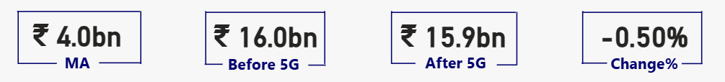
₹31.9bn ▼ -0.50%
Total Revenue
Total revenue has decreased by 0.50%, indicating a need for strategic initiatives despite increasing ARPU, highlighting the challenge of a shrinking customer base.

Slide 4
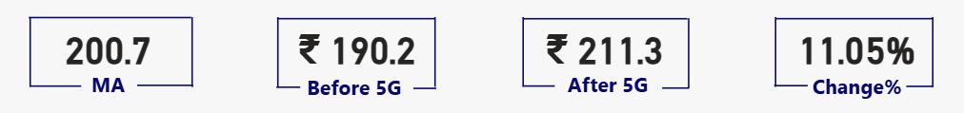
₹200.7 +11.05%
Average Revenue Per User
ARPU has shown significant raise of 11.05% despite the
fact is Monthly active users has lowered to 8.28% and
monthly users unsubscribed rate is noticeably higher
23.50%

Slide 5
Conclusion
This is only possible when 5G plan prices must be very high and that could be the reason for declined in monthly active user rate , rise in rate for monthly unsubscribed user as well as very little change in Avg. Revenue post 5G launch.
Somewhere higher prices for 5G plans in compensating the effect for higher monthly unsubscribed user rate.

Slide 6
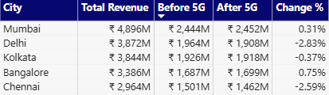
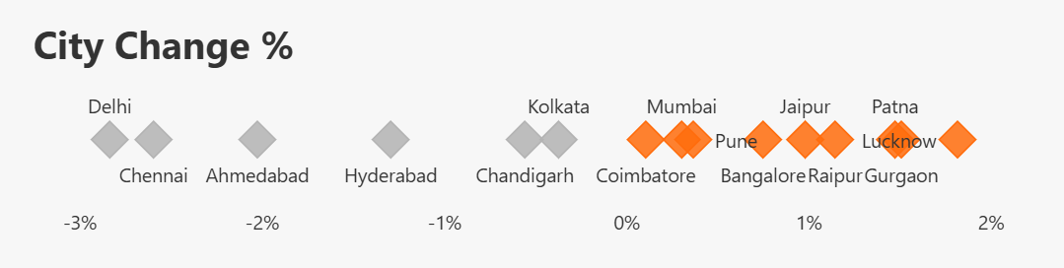
Revenue Analysis
Mumbai, Delhi, Kolkata, Banglore & Chennai are the Top 5 cities in Average Revenue.
In Delhi, Chennai, Ahmedabad, Hyderabad, Chandigarh & Kolkata AVG. Revenue found to be declining for Post 5G Launch Period.
Mumbai, Bangalore & Pune are few cities some of the Top revenue contributors which have shown positive growth of AVG Revenue for Post 5G Launch Period

Slide 7
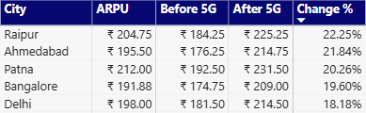
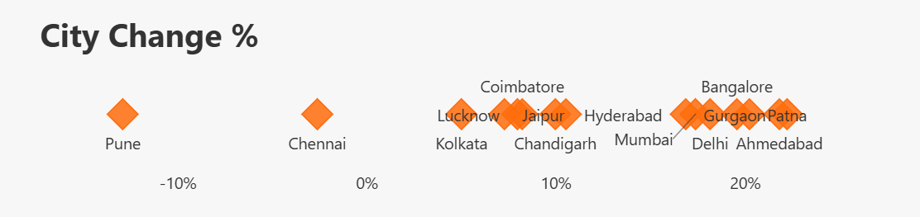
Revenue Analysis
ARPU has shown better performance in post 5G Launch compared to declined in AVG Revenue for most cities.
Pune has sharp decline of 12.88% in ARPU which is making it outlie.
Mumbai, Bangalore & Delhi are few cities some of the Top revenue contributors which have shown Outstanding growth of in ARPU for Post 5G Launch Period.

Slide 8
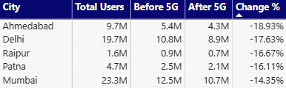
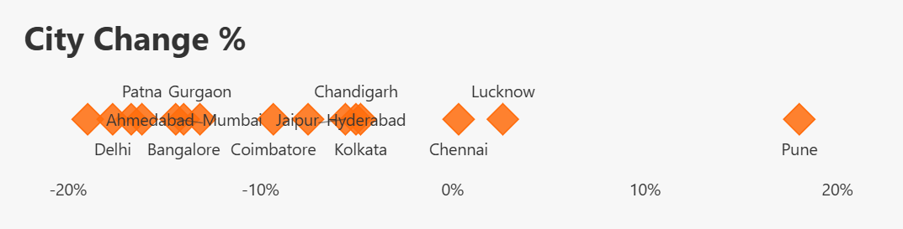
User Analysis
Ahmedabad, Delhi, Raipur, Patna and Mumbai are the Top cites for No. of Active users change in Post 5G Period.
Ahmedabad has the highest -ve growth in Active user.
Cities like Mumbai, Delhi & Bangalore which are Top contributor n AVG. Revenue have shown significantly higher -ve growth in No. of Active user for post 5G period.
Once Again Pune is clear outlier showing 18.06% positive growth n Active Users for Post 5G Period.

Slide 9
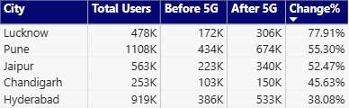
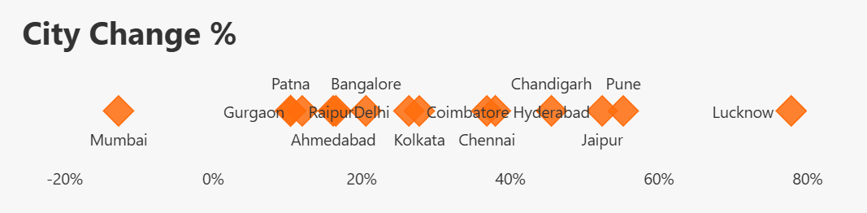
User Analysis
Except Mumbai all cities can be considered to be failed in retaining their subscribers
Lucknow has significantly higher Monthly unsubscribed user rate which shows it’s poor performance for Post 5G
Mumbai has shown noticeable -ve growth in Monthly Unsubscribed User for Post 5G, which is actually a positive sign

Slide 10
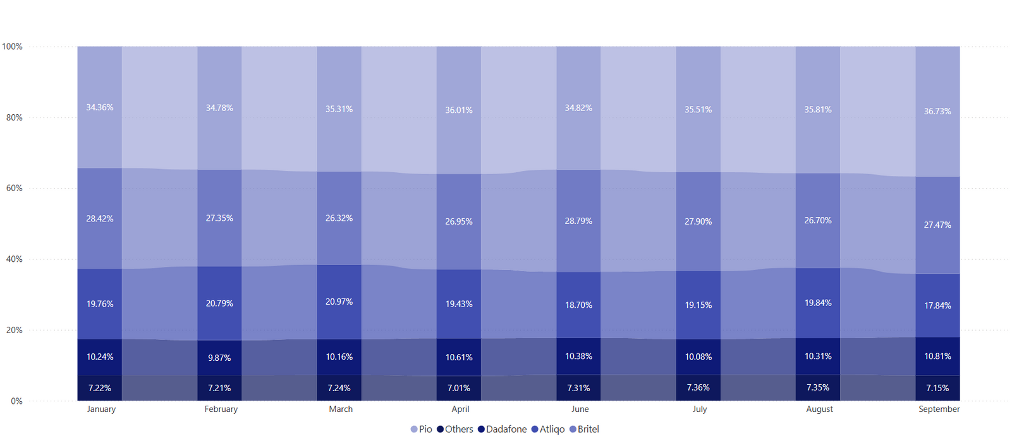
Market Share Dynamics
Competitive Positioning Overview
The market share landscape remains challenging, with Leader Pio dominating at approximately 35–37%. Meanwhile, AtliQo's position has stagnated around 10–11%, highlighting low competitive gain since the introduction of 5G.
Pre 5G: 20.24%
Post 5G: 18.88%
▼: -06.69%

Slide 11
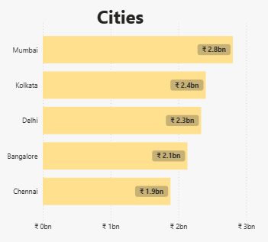
Revenue Performance Overview
Insights into Key Cities
Mumbai continues to be the largest revenue hub for AtliQo despite experiencing low growth. Meanwhile, Delhi faces a decline in revenue, while Bengaluru shows positive margins, indicating resilience.

Slide 12
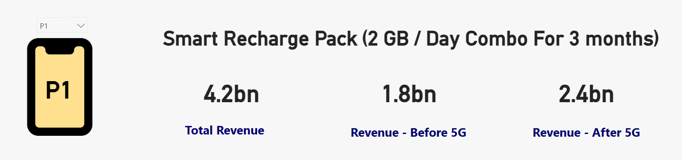
Plan P1 Performance
Success of Smart Recharge
The Smart Recharge Pack has shown remarkable growth, increasing revenue from ₹1.8bn to ₹2.4bn post-5G launch, highlighting the importance of aggressive promotion of bundled plans.

Slide 13
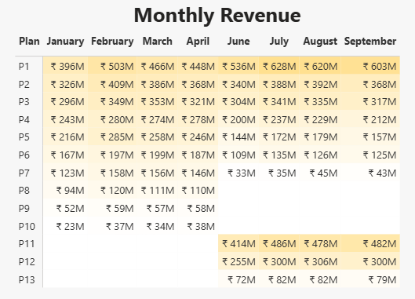
Plan Analysis
Plan P1 has been leading with highest revenue in both phases
P2 & P3 has been almost maintaining its revenue levels in Per & Post 5G launch periods
There is a declined P4, P5 & P6 has been almost maintaining its revenue levels in Pre & Post 5G period
P7 has sharp declined in Revenue for Post 5G
P8, P9 & P10 has been discontinued in post 5G, Neither of them have performed well in pre 5G launch period.
P11, P12 & P13 has been introduced post 5G. Out of that P11 has been most successful and P13 is not performing well

Slide 14
Strategic Recommendations
Metro Churn-Reduction
Affordable Plans
Implement targeted marketing campaigns to reduce churn rates in metro areas, enhancing customer retention through tailored incentives and personalized services.
Develop competitive entry-tier 5G plans that attract budget-conscious consumers, expanding market reach and increasing overall user adoption in diverse demographics.
Bundled Ecosystem
Retention Rewards
Create a comprehensive app and content bundled ecosystem to enhance customer engagement, fostering loyalty through exclusive offerings and unique experiences.
Introduce retention rewards for long-term users, providing incentives for loyalty that will strengthen relationships and reduce the risk of churn in key segments.
Tier-2 Focus
Prioritize expansion efforts in Tier-2 cities, capitalizing on growth opportunities and fostering a strong customer base in emerging markets for enhanced revenue.

Slide 15
DASHBOARD SCREENSHOT

Slide 16
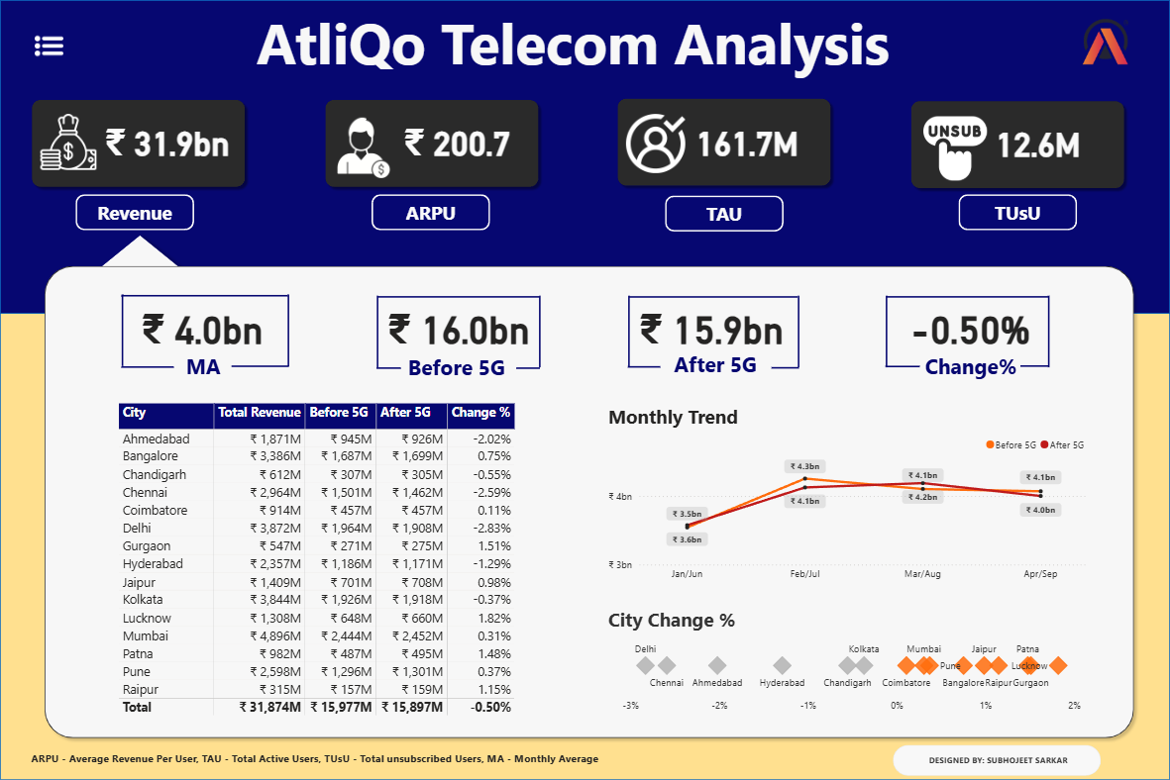

Slide 17
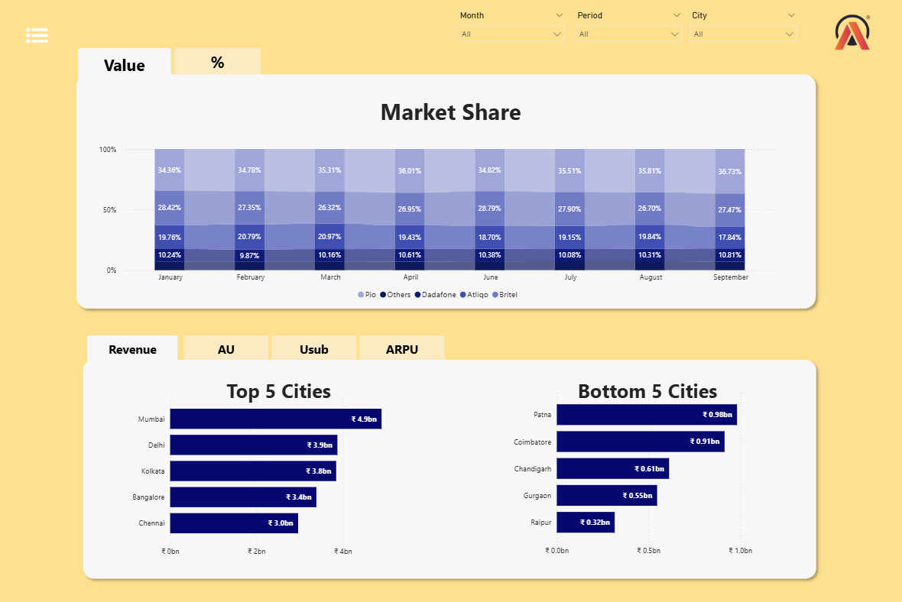

Slide 18
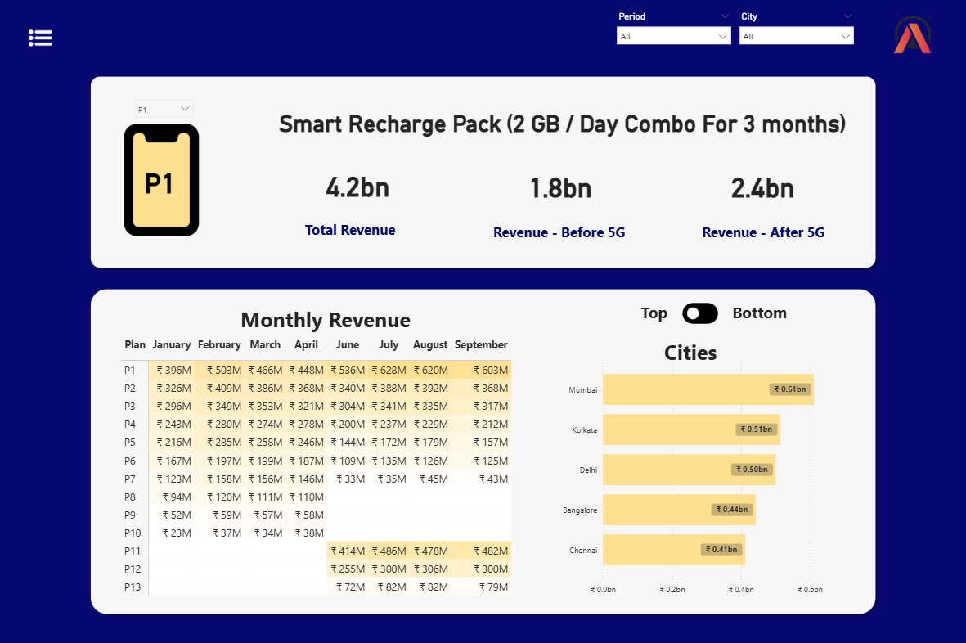

Slide 19
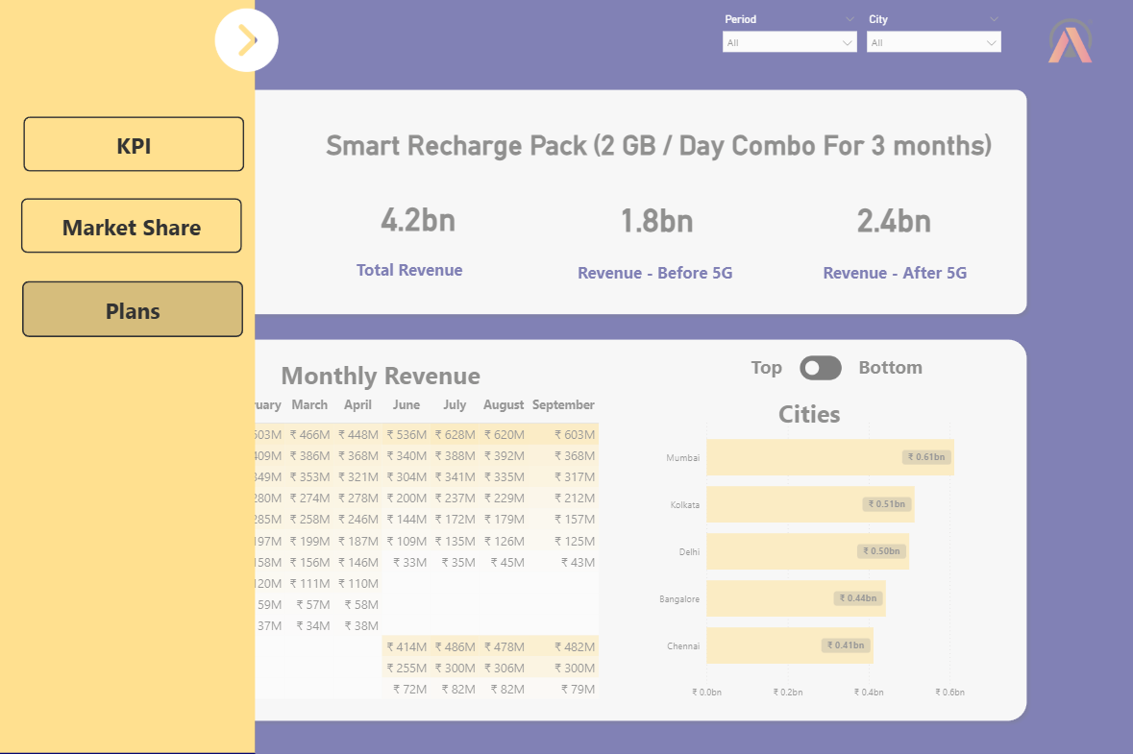

Slide 20
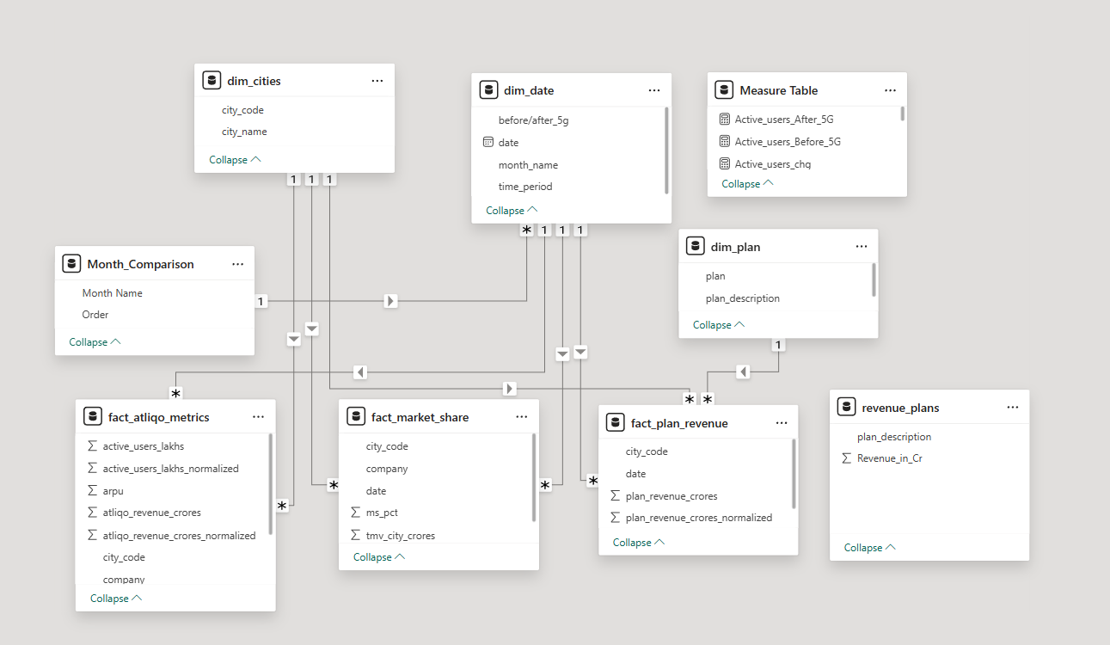

Slide 21
THANKYOU

